Slide 1
Electromagnetics --- by Cheng Wang

Slide 2
Information of Instructor
Weeks 1-8
Cheng Wang （王成）
Office: SIST, 1D401e
Telephone: 20685263
Email: wangcheng1@shanghaitech.edu.cn
Email writing…
Weeks 9-16
Xiong Wang （王雄）
Email: wangxiong@shanghaitech.edu.cn

Slide 3

EM WeChat Group

Slide 4
Textbook
F. T. Ulaby and U. Ravaioli,
Fundamentals of Applied Electromagnetics (7th Edition)
Pearson Education Inc., 2015.
(PDF version on 互动教学平台)

Slide 5
Basic Information of this Course
Electromagnetics (电磁学), 4 credits (16 weeks)
Classroom: Teaching Center Rm. 302
Lecture: Tue. & Thur. 10:15 ~ 11:55 (upload on Mon. & Wen. before 12h00)
Q&A: Fri. at 18h00-19h30 (by TA)
Homework: Distribution every chapter
Quiz: Starting from March 30th （depends）
Lab: Starting from March 30th （depends）
Score: Homework & Quiz (30%)+MidExame (20%)+FinExame (30%) +Lab (20%)
互动教学平台: 电磁学-2020春 (slides, video, homework, Q&A, etc.)

Slide 6
Information TAs and Lab Teacher
TAs (course) 张乐嘉 zhanglj@shanghaitech.edu.cn (Group 1)
张正枰 zhangzhp1@shanghaitech.edu.cn (Group 2)
曹淑婕 caoshj@shanghaitech.edu.cn (Group 3) TAs (lab) 刘力豪 liulh@shanghaitech.edu.cn 姜昱同 jiangyt@shanghaitech.edu.cn 张津萌 zhangjm1@shanghaitech.edu.cn 姚进 yaojin@shanghaitech.edu.cn
Lab teacher 李娟 lijuan@shanghaitech.edu.cn

Slide 7
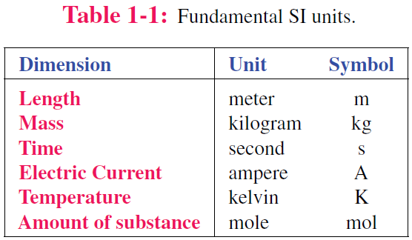
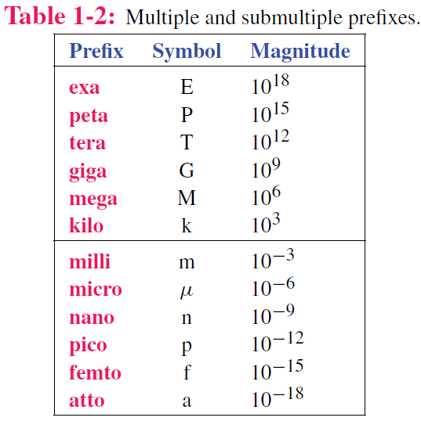
Dimensions and Units
艾
拍
太
Luminous intensity candela cd
皮
飞
阿

Slide 8
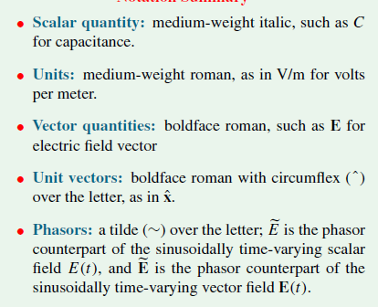
Symbol Notations

Slide 9
Examples of EM Applications

Slide 10
Histories make men wise—Francis Bacon
1820s, Henry, electric motor: E-field→M-field
1830s, Faraday, electric generator: M-field→ E-field
1873, Maxwell, Maxwell’s equation, predict EM waves
1880s, Hertz, demonstrate EM (radio) waves
1890s, Thomas, identify electrons, with electrical charge
1900s, Einstein, photoelectric effect

Slide 11
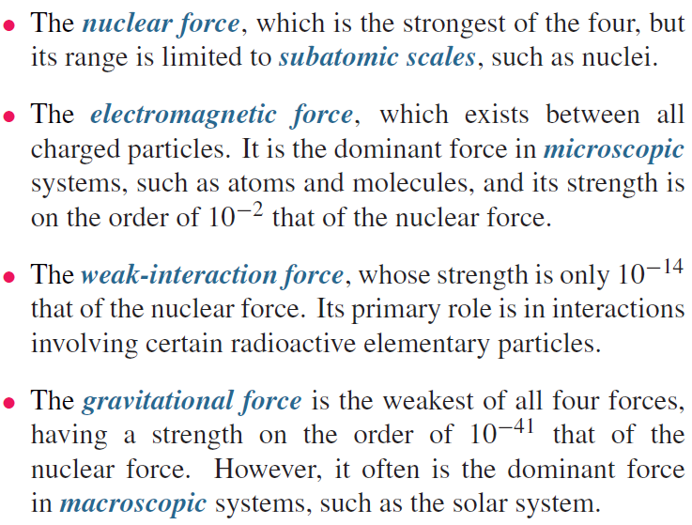
Fundamental Forces of Nature
Subatomic
scale

Slide 12
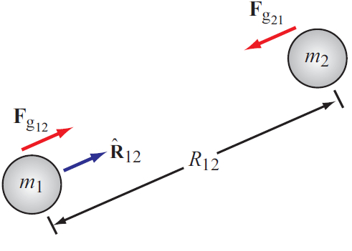
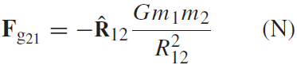
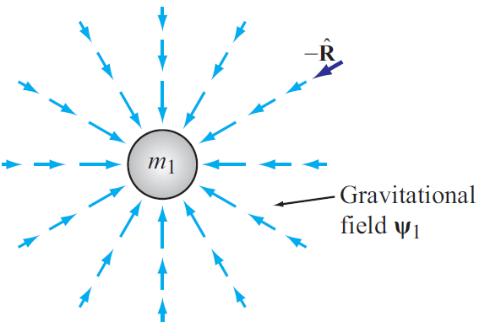
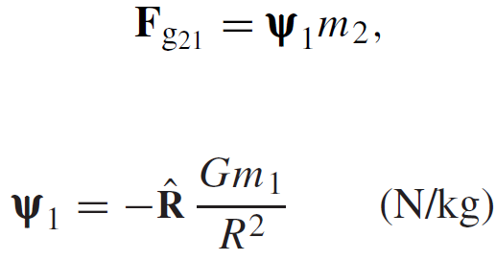
Gravitational Force
Force exerted on mass 2 by mass 1
Action at a distance
Gravitational FIELD induced by mass 1

Slide 13
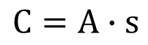
Charge: Electrical property of particles
Units: coulomb
Charge of an electron
One coulomb: amount of charge accumulated in one second by a current of one ampere.
e = 1.602 x 10⁻¹⁹ C
Charge conservation
The coulomb is named for a French physicist, Charles-Augustin de Coulomb (1736-1806), who was the first to measure accurately the forces exerted between electric charges.
Cannot create or destroy charge,
only transfer
$$C=A∙s$$

Slide 14
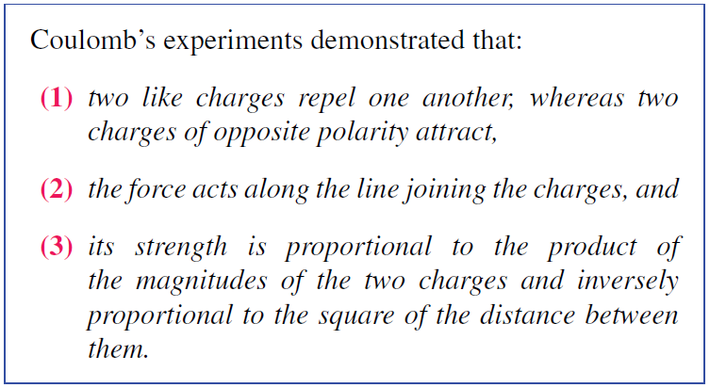
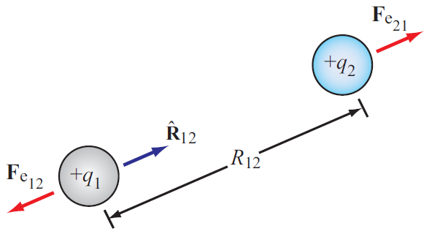
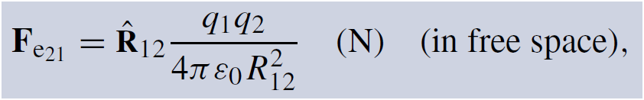
Electrical Force
Two differences between F_{g} and F_{e}
Force exerted on charge 2 by charge 1
Permittivity of free space
ε₀ = 8.854 × 10⁻¹² farad per meter (F/m)

Slide 15
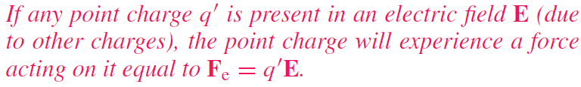
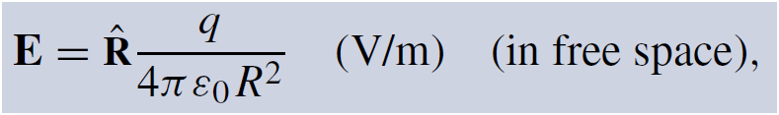
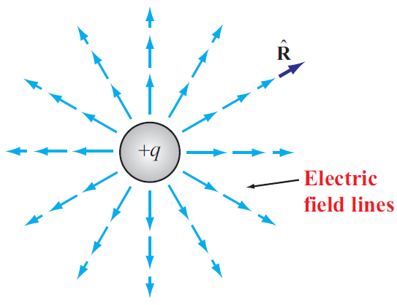
Electric Field In Free Space
Permittivity of free space

Slide 16
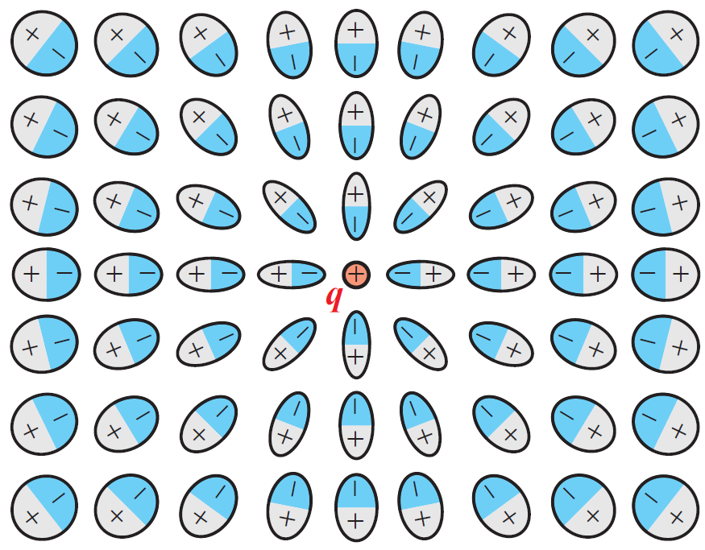
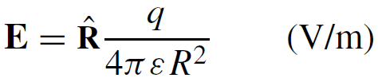
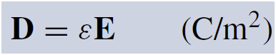
Electric Field Inside Dielectric Medium
Polarization of atoms changes electric field
New field can be accounted for by changing the permittivity
Permittivity of the material
Another quantity used in EM is the electric flux density D:
Electric dipole
Dielectric constant

Slide 17
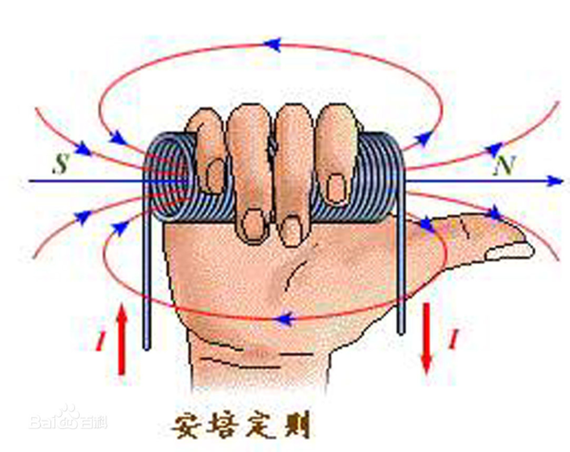
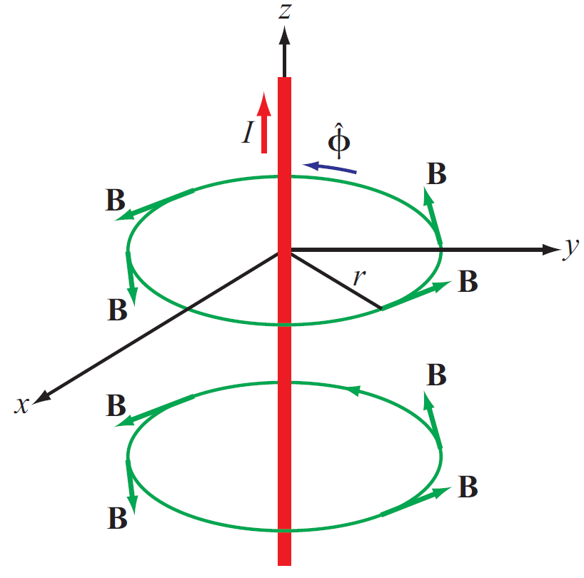
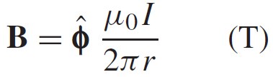
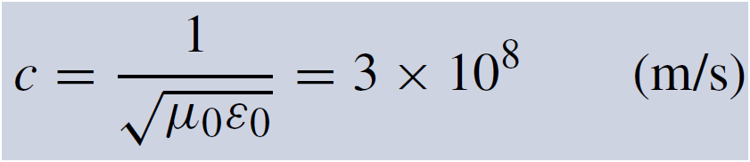
Magnetic Field In Free Space
Electric charges can be isolated, but magnetic poles always exist in pairs.
Magnetic flux density induced by a current in a long wire
Magnetic permeability of free space
Electric and magnetic fields are connected through the speed of light:

Slide 18
Magnetic Field In ferroM material
The Magnetic permeability of ferromagnetic material becomes
Relative magnetic permeability
Magnetic flux density relation with magnetic field intensity

Slide 19
Statics vs. Dynamics
Electrostatics (does not change with time)
Magnetostatics (does not change with time)
Electromagnetics (vary with time, i.e. time-varying)
Electrostatics
DC
Decoupled
Fields
Force
Magnetostatics
Electromagnetics
AC
Coupled
Waves
Energy

Slide 20
Fields of Moving Charges
A static charge produces static electric field at the speed of light
When a charge is moving, the generated electric fields change accordingly, and current is generated
When the charge moves with acceleration, the generated electric fields exhibit oscillating natures, which will in turn generate magnetic fields and form electromagnetic fields

Slide 21
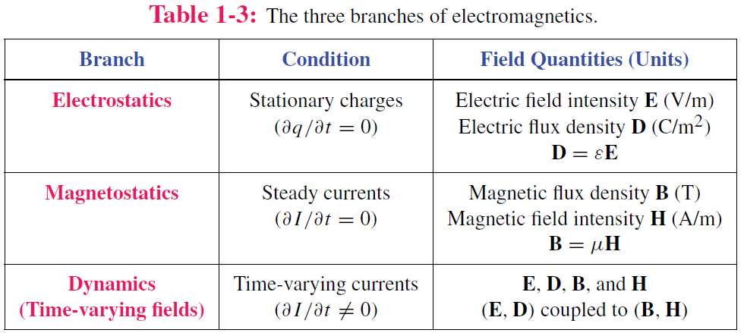
Static vs. Dynamic
Static conditions: charges are stationary or moving, but if moving, they do so at a constant velocity.
Under static conditions, electric and magnetic fields are independent, but under dynamic conditions, they become coupled.

Slide 22
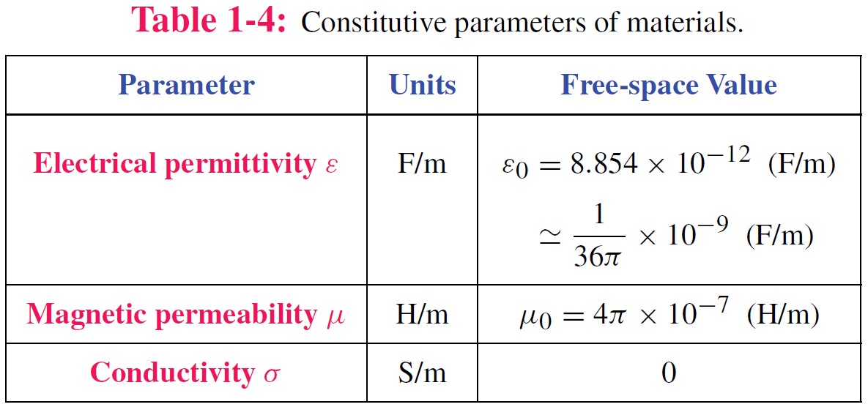
Material Properties

Slide 23
Traveling Waves
Waves carry energy
Waves have velocity
Many waves are linear: they do not affect the passage of other waves; they can pass right through them
Transient waves: caused by sudden disturbance
Continuous periodic waves: repetitive source

Slide 24
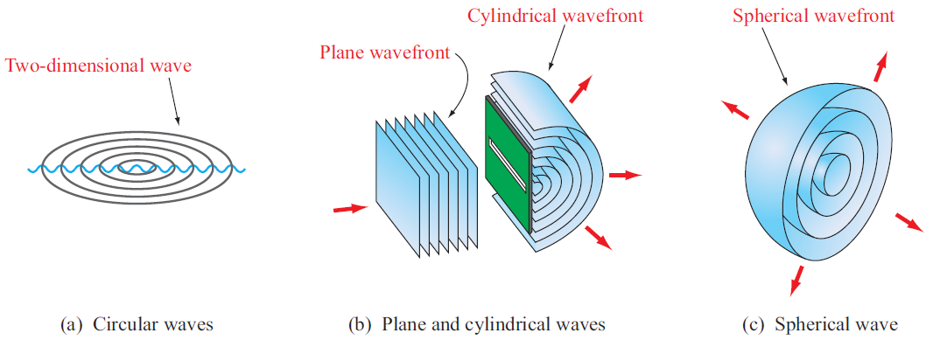
Types of Waves
Surface with equal phase

Slide 25
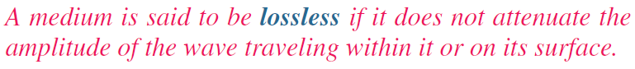
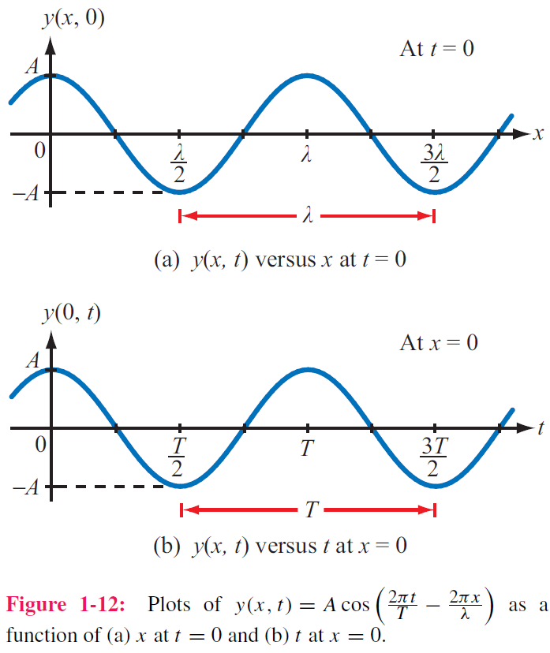
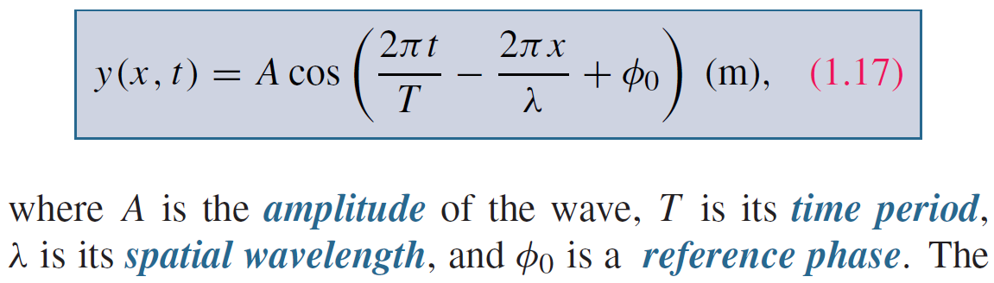
Sinusoidal Waves in Lossless Media
Take wave on water as an example
y = height of water surface
x = distance
Function of both time and space

Slide 26
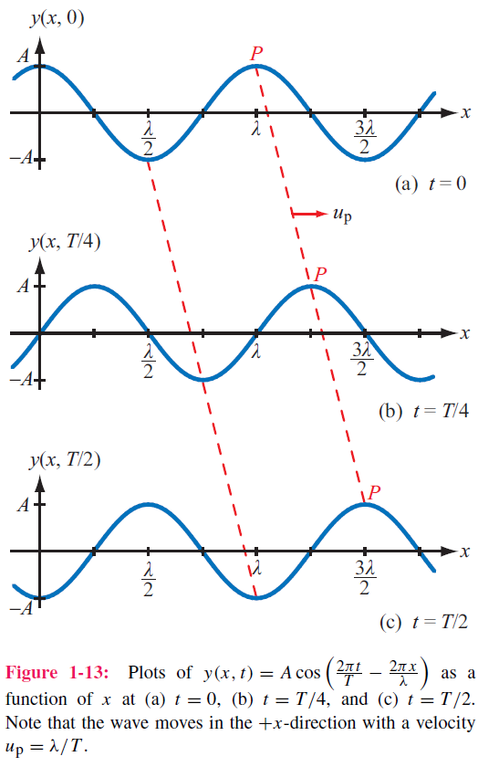
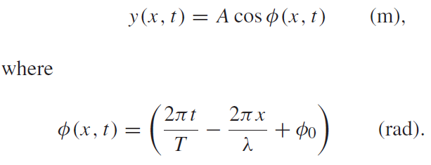
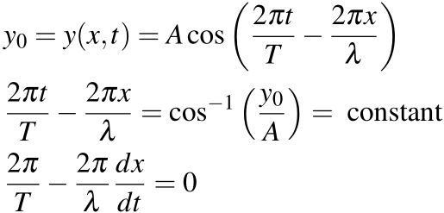
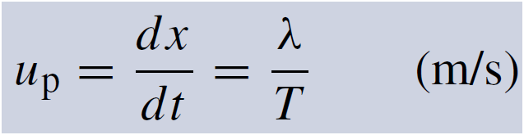
Phase velocity
If we select a fixed height y₀ and follow its progress, then

Slide 27
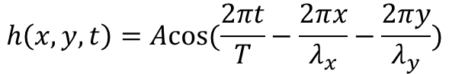
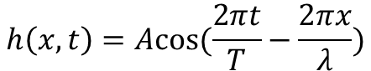
More Interpretation of Spatial Variables
The spatial variables in the cos function represent the directions in which the wave has propagation
$$h\left(x,t\right)=Acos(\frac{2πt}{T}−\frac{2πx}{λ})$$
$$h\left(x,y,t\right)=Acos(\frac{2πt}{T}−\frac{2πx}{λ_{x}}−\frac{2πy}{λ_{y}})$$

Slide 28
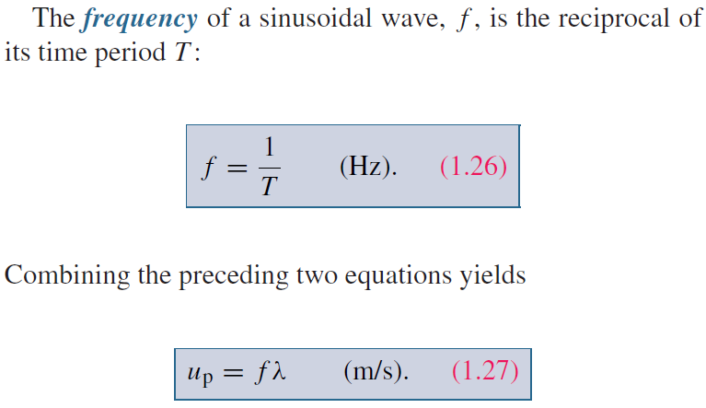
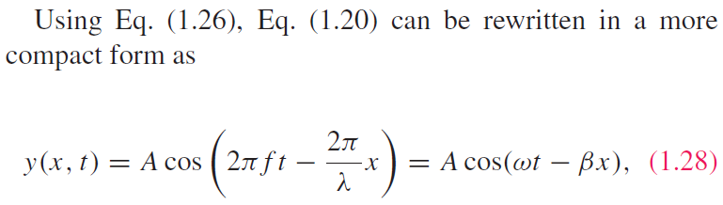
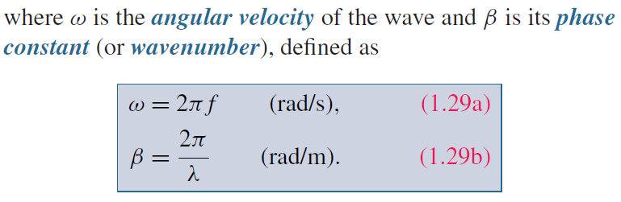
Wave Frequency and Period

Slide 29
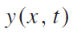
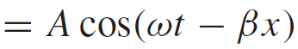
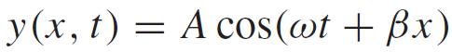
Direction of Wave Travel
Wave travelling in +x direction
As t increases, x has to increase to make (ωt − βx) constant
Wave travelling in ‒x direction
As t increases, x has to decrease to make (ωt + βx) constant
+x direction: if coefficients of t and x have opposite signs
‒x direction: if coefficients of t and x have same sign (both positive or both negative)

Slide 30
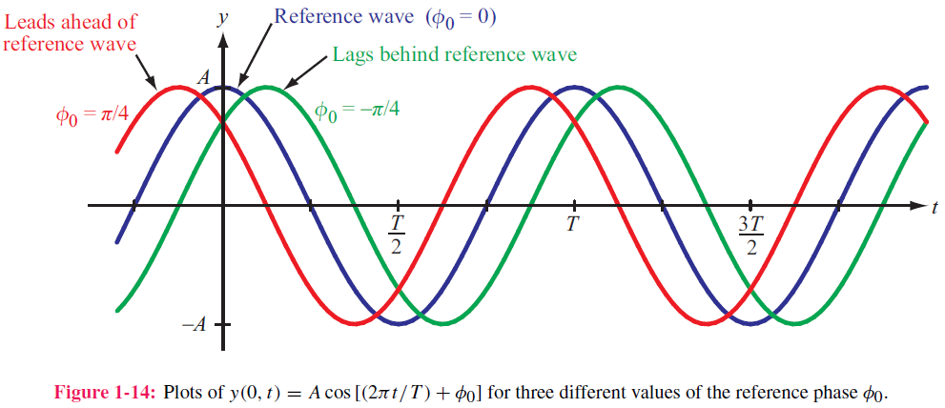
Phase Lead & Lag
t₀
t₀−T/8
t₀+T/8

Slide 31
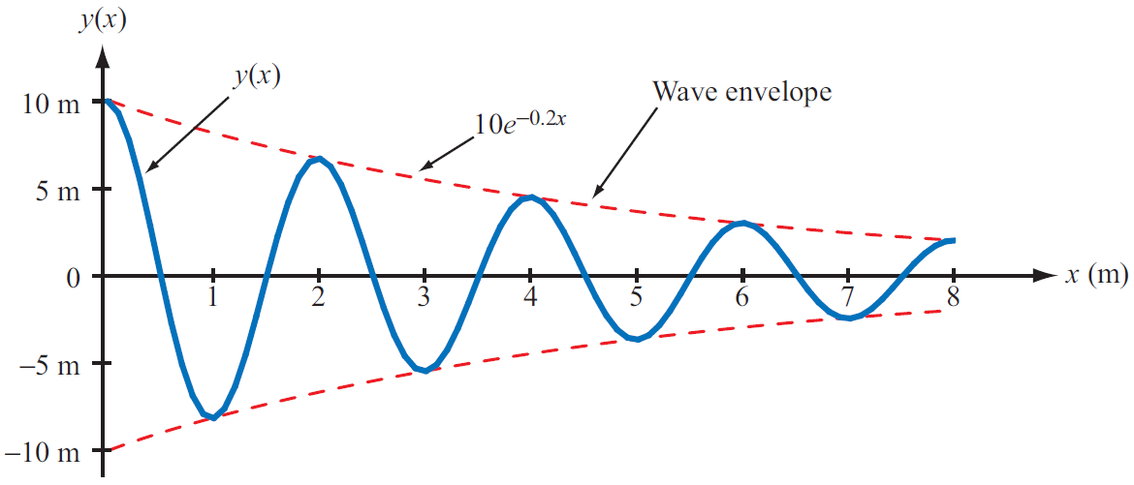
Wave Travel in Lossy Media
Frequency does not change
Attenuation factor

Slide 32
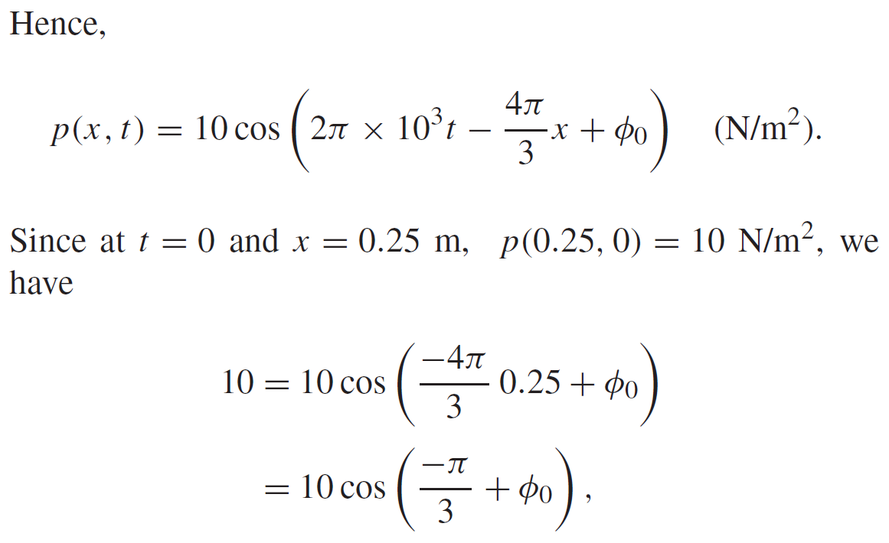
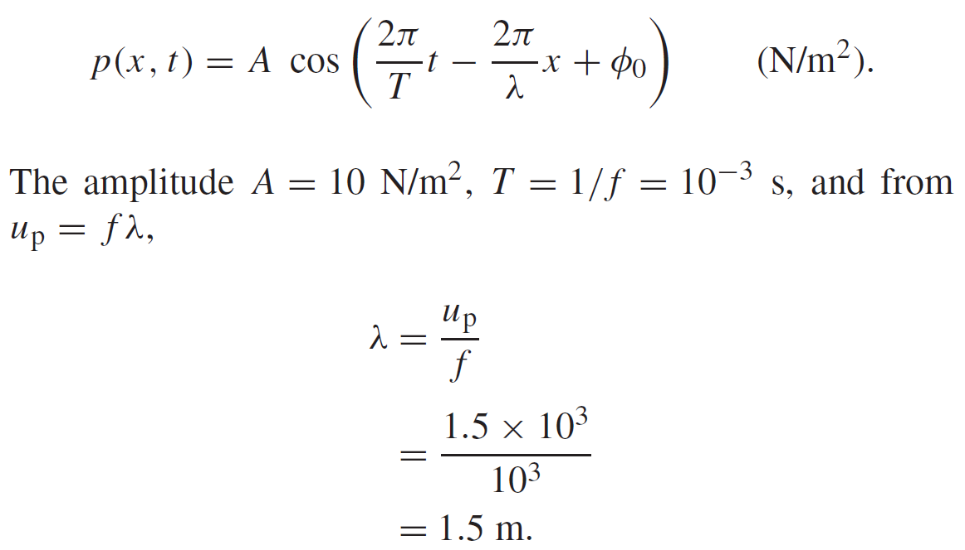
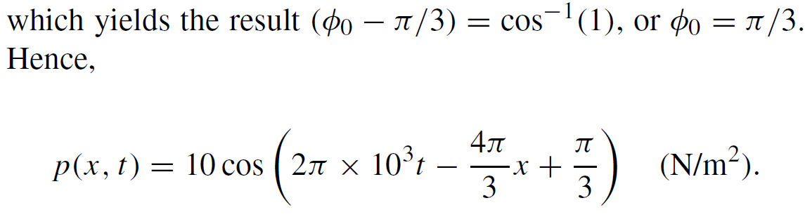
Example 1-1: Sound Wave in Water
Given: sinusoidal sound wave traveling in
the positive x-direction in water
Wave amplitude is 10 N/m2, and p(x, t) was observed to be at its maximum value at t = 0 and x = 0.25 m. Also f=1 kHz, u_{p}=1.5 km/s.
Determine: p(x,t)
Solution:

Slide 33
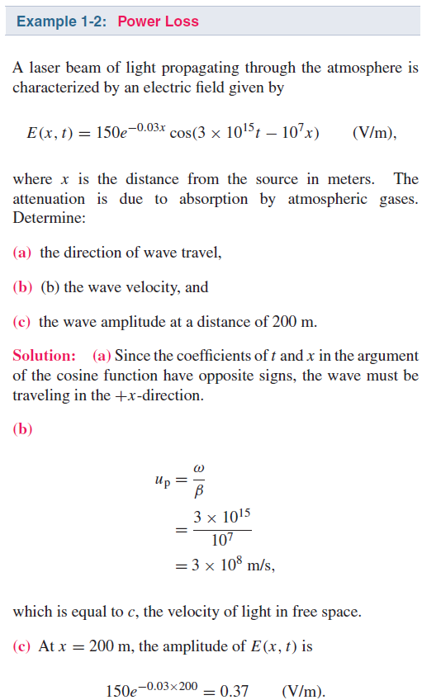

Slide 34
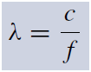
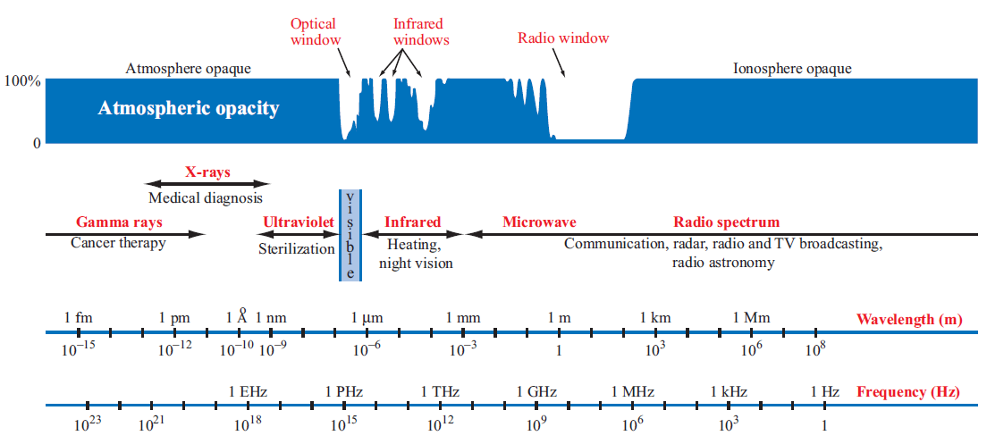
The EM Spectrum

Slide 35
The EM Spectrum
Radio wave wavelength>1mm
Infrared 760 nm ~ 1mm (NIR, MIR, FIR)
Visible 400 nm~760 nm
Ultraviolet 1nm ~400 nm
X-ray 1 pm~1nm
Gamma-ray < 1 pm
Microwave 1 mm~ 1m, 0.3 GHz~0.3THz (mmW, cmW, dmW)
Terahertz wave 0.1mm~1mm, 0.3 THz~3 THz

Slide 36
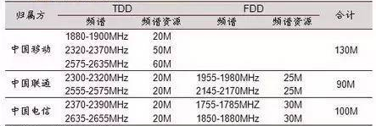
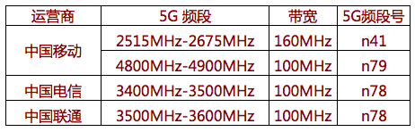
4G & 5G

Slide 38

Complex Numbers
We will find it is useful to represent sinusoids as complex numbers
Rectangular coordinates
Polar coordinates
Relations based on Euler’s Identity

Slide 39

Relations for Complex Numbers

Slide 40

Phasor Domain
Linearied version of frequency domain
f(t) is sinusoidal signal
1. The phasor-analysis technique transforms equations from the time domain to the phasor domain.
2. Integro-differential equations get converted into linear equations with no sinusoidal functions.
3. After solving for the desired variable--such as a particular voltage or current-- in the phasor domain, conversion back to the time domain
provides the same solution that would have been obtained had the original integro-differential equations been solved entirely in the time domain.

Slide 41


Phasor Domain
Phasor counterpart of $v(t)$
Phase is needed

Slide 42

Time and Phasor Domain
It is much easier to deal with exponentials in the phasor domain than sinusoidal relations in the time domain
Just need to track magnitude/phase, knowing that everything is at frequency ω

Slide 43

Phasor Relation for Resistors
Current through resistor
Time Domain
Frequency Domain
Time domain
Phasor Domain

Slide 44


Phasor Relation for Inductors
Time domain
Phasor Domain
Time Domain

Slide 45



Phasor Relation for Capacitors
Time domain
Phasor Domain

Slide 46

Example
Sine reference
Integral property
Cosine reference

Slide 47







ac Phasor Analysis: General Procedure

Slide 48
Example 1-4: RL Circuit
Cont.

Slide 49
Example 1-4: RL Circuit cont.

Slide 50

Travelling Waves in Phasor Domain

Slide 51

Summary
Homework due xxx

